Slide 1


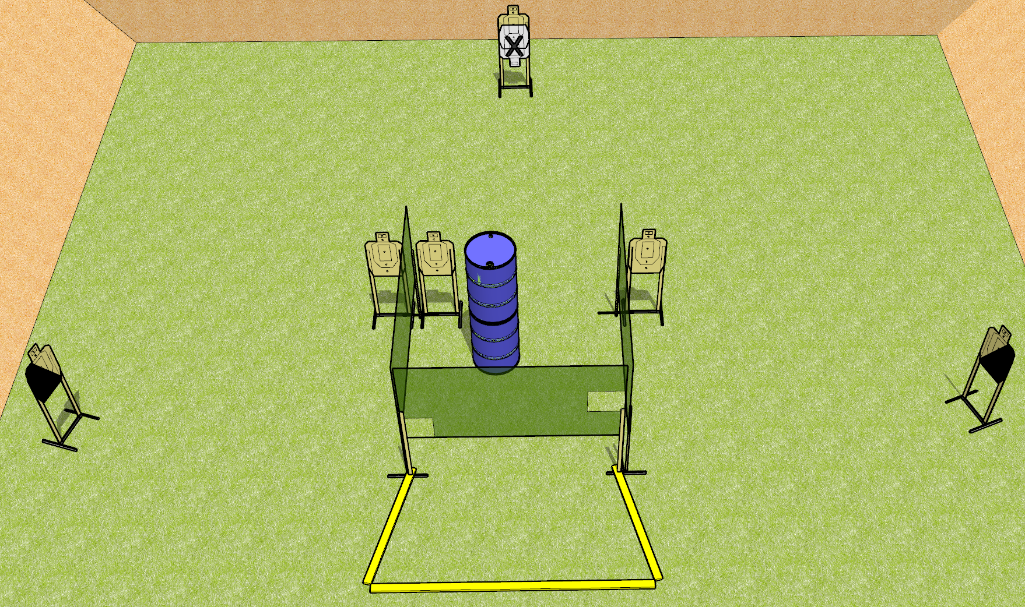
 | Dothan Gun Club – USPSA Match Simply Short Course Designer : Drew Coleman
Round Count 12 rounds 6 USPSA targets
Equipment List 4 wall feet 2 medium fault lines 1 left + 1 right diag, 5 targets (4 + 1NS)

Slide 2
Simply Short
Written Stage Briefing
Scoring: Virginia Count
Targets: 6 USPSA
Rounds: 12
Handgun start position: behind the rear fault line, completely outside the shooting area, wrists below belt. Handgun is loaded and holstered.
PCC start position: behind the rear fault line, completely outside the shooting area, stock on belt. Carbine is loaded.
Procedure: On the audible start signal, engage targets as they become available from within the shooting area.

